Slide 1

Development of an Assembly Robot
Team 15
Xander Irvine-Fortescue
Sylvain Jannin
Seun Ojuoko
Bethany Livingstone
Adrian Wendland
1st April 2022

Slide 2
Scenario (Adrian)
Must design, manufacture and control a robotic arm which can pick up a pin and insert it into the hole of a cylindrical bar.
Project budget of £60 + any components laying around.
Task is open-ended, fairly simple.
Means many different options for design.

Slide 3
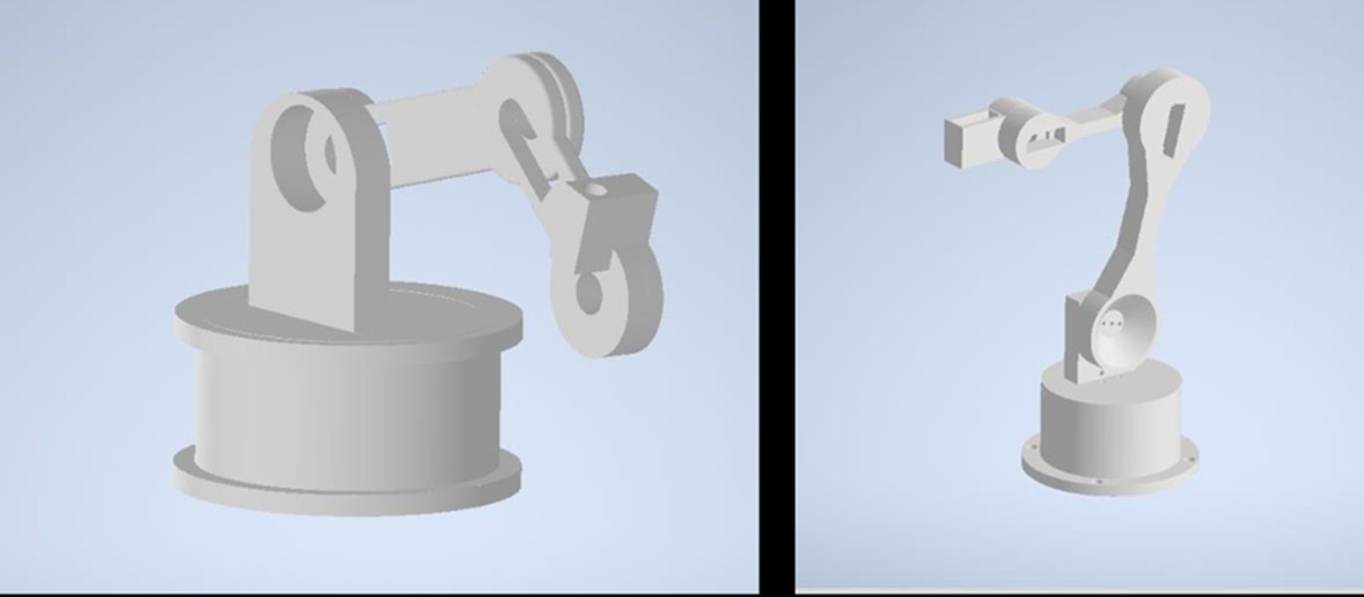
Design & Evolution
1st CAD model
2nd CAD model
4 Links and 4 servos for both initial CAD models
Servos
3x HS-645MG Servo
1x S3-003 Servo
1x SG-90 Micro-servo

Slide 4
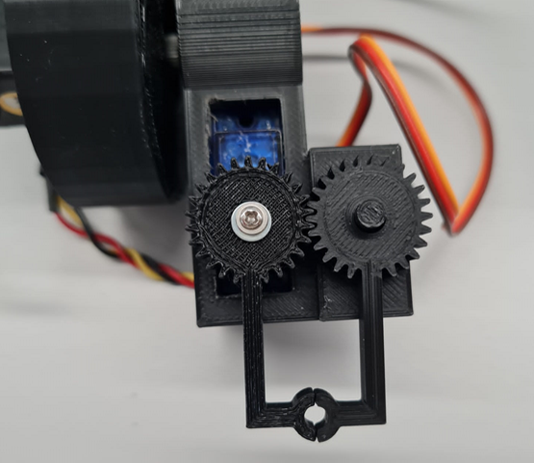
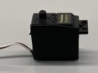
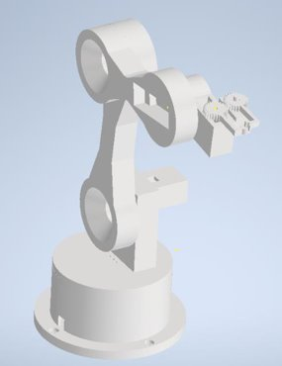
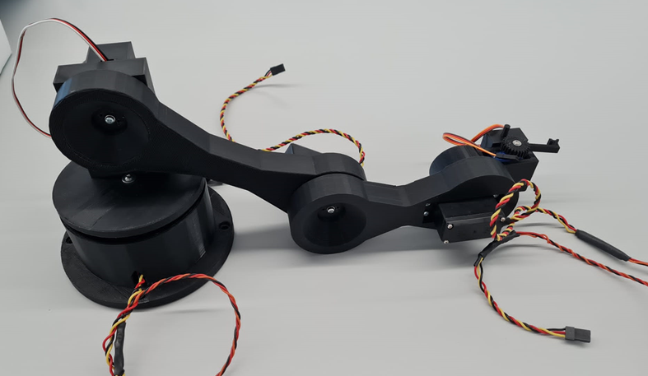
Final Design/Assembly
Damaged S3-003 servo
End effector with grippers
CAD model for final assembly
Full robotic arm
5 Links and 5 servos for the final CAD model

Slide 5
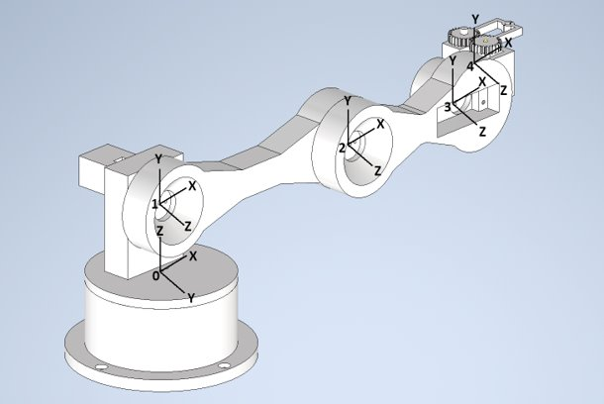
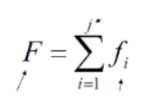
Kinematic Design
Inverse kinematics, forward kinematics, singularity, workspace, kinematic/dynamic simulation
Local co-ordinate systems for each joint with respect to DH.
 | r (mm) | α | d (mm) | θ
0-1 | 0 | -90 | 47.5 | θ1
1-2 | 151 | 0 | 0 | θ2
2-3 | 100 | 0 | 0 | θ3
3-4 | 55 | 0 | 0 | θ4
DH Table

Slide 6
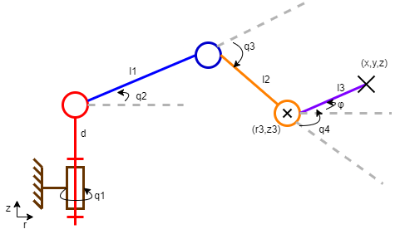

Inverse Kinematics
$r=\sqrt{x^{2}+y²}$
$r_{3}=r−l_{3}cos⁡(φ)$
$z_{3}=z−l_{3}sin⁡(φ)$
$q_{1}=atan2(y,x)$
$q_{3}= −arcos\left(\frac{{r_{3}}^{2}+{z_{3}}^{2}−({l_{1}}^{2}+{l_{2}}^{2})}{2l_{1}l_{2}}\right)$
$q_{2}=\operatorname{atan}\left(\frac{z_{3}}{r_{3}}\right)+atan\left(\frac{l_{2}sin(q_{3})}{{l_{1}+l}_{2}cos(q_{3})} \right)= \operatorname{atan}{2\left(z_{3}, r_{3}\right)}+atan2\left(l_{2}sin(q_{3}), {l_{1}+l}_{2}cos(q_{3})\right)$
$q_{4}=φ−(q_{2}+q_{3})$
Kinematic representation of the robotic arm.

Slide 7
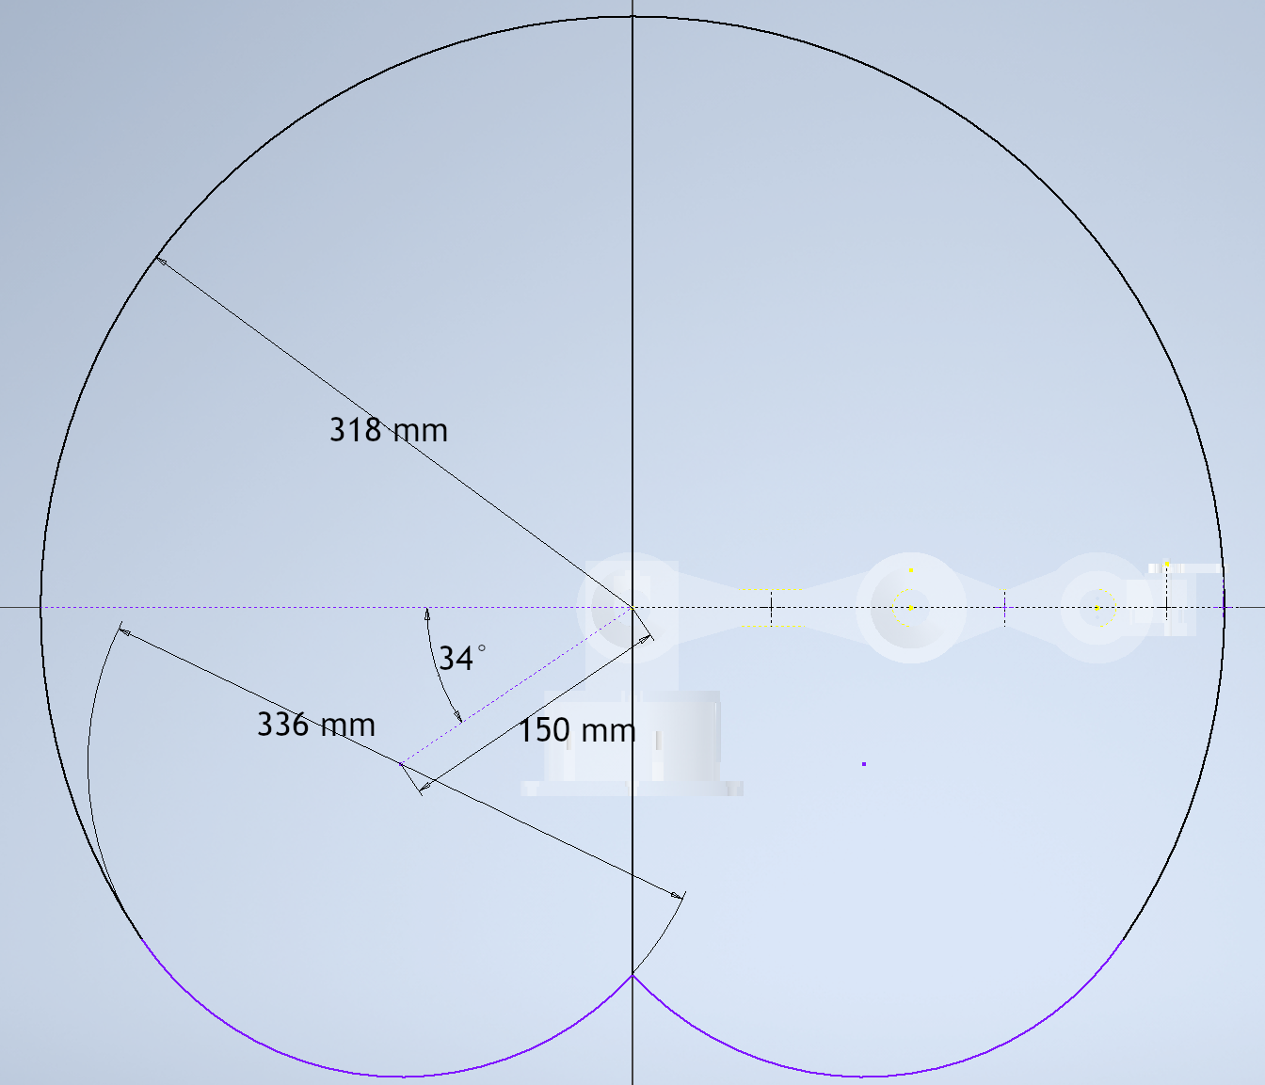
Workspace Analysis (Adrian)
Workspace is a 318mm radius sphere (almost).
Bottom of workspace limited due to size of rotating base limiting movement of first link.
Workspace of the robot arm, robot arm is transparent in background.

Slide 8
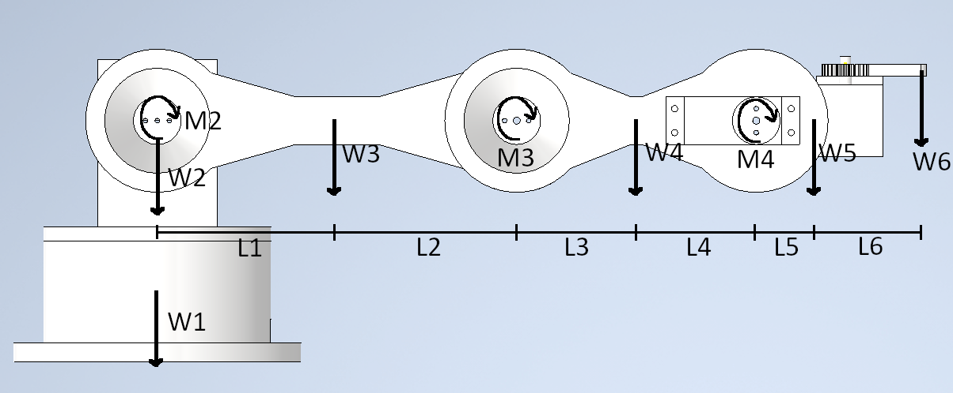



Static Analysis (Adrian)
To determine how strong motors must be.
Masses from Inventor with parts designated as PLA.
Inventor assumes solid PLA, but parts are infilled. Masses multiplied by infill to get true mass.
Joint | Moment (Nmm)
2 (M2) | 175
3 (M3) | 56
4 (M4) | 14
Static analysis of the robot arm at max extension holding a pin at W6.
$$M_{2}=\left(L_{6}+L_{5}+L_{4}+L_{3}+L_{2}+L_{1}\right)W_{6}+\left(L_{5}+L_{4}+L_{3}+L_{2}+L_{1}\right)W_{5}+\left(L_{3}+L_{2}+L_{1}\right)W_{4}+L_{1}W_{3}$$
$$M_{3}=\left(L_{6}+L_{5}+L_{4}+L_{3}\right)W_{6}+\left(L_{5}+L_{4}+L_{3}\right)W_{5}+L_{3}W_{4}$$
$$M_{4}=\left(L_{6}+L_{5}\right)W_{6}+L_{5}W_{5}$$

Slide 9
3D Animation
Animation of the robotic arm picking up a pin and dropping it into the pin holder.

Slide 10
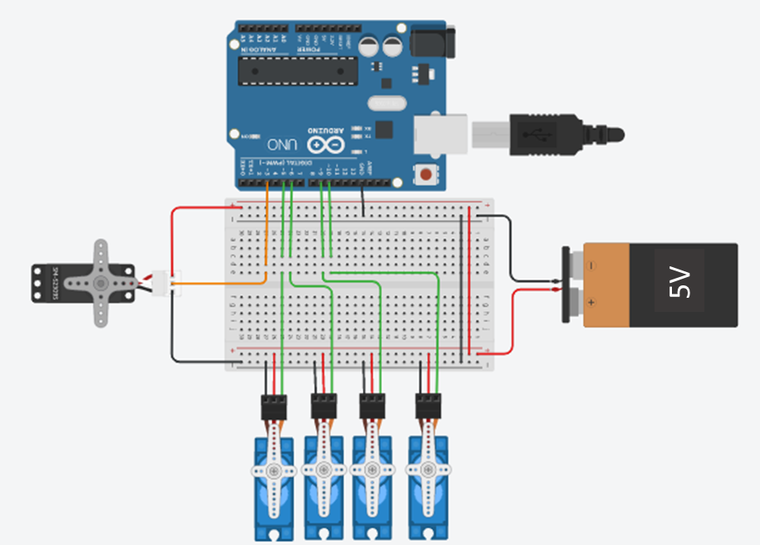
Electronic Design
A programmable Arduino controlled the five servo motors
Servo motors would be powered by a 5V 3A supply
PWM signals from the ports activated servo motors
Enables precise movement for the assembly robot
Sequence of events depends on the programmable control for the Arduino
Circuit diagram of electronics used in the robotic arm

Slide 11
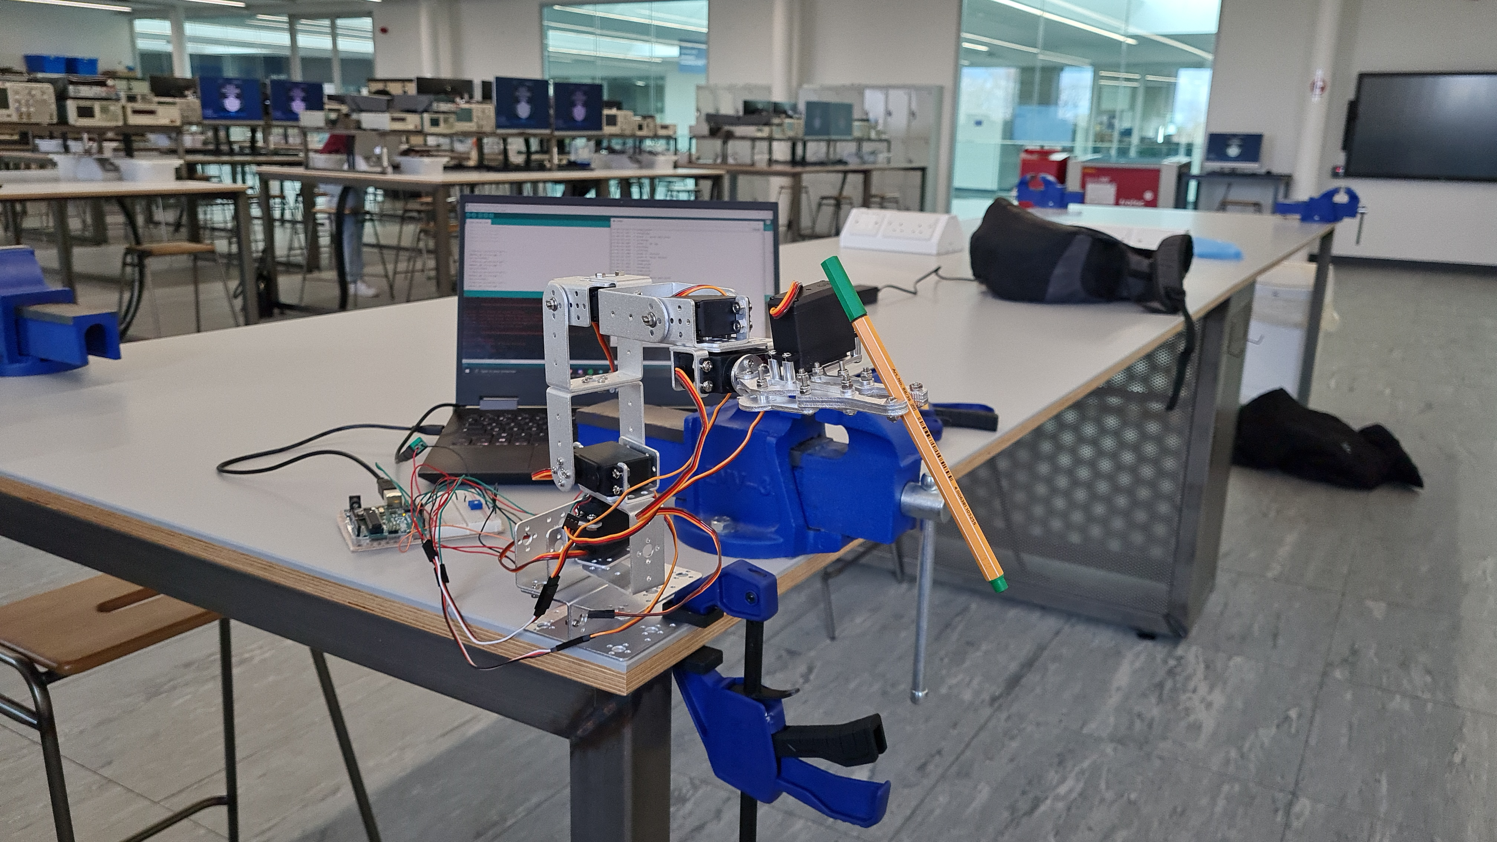
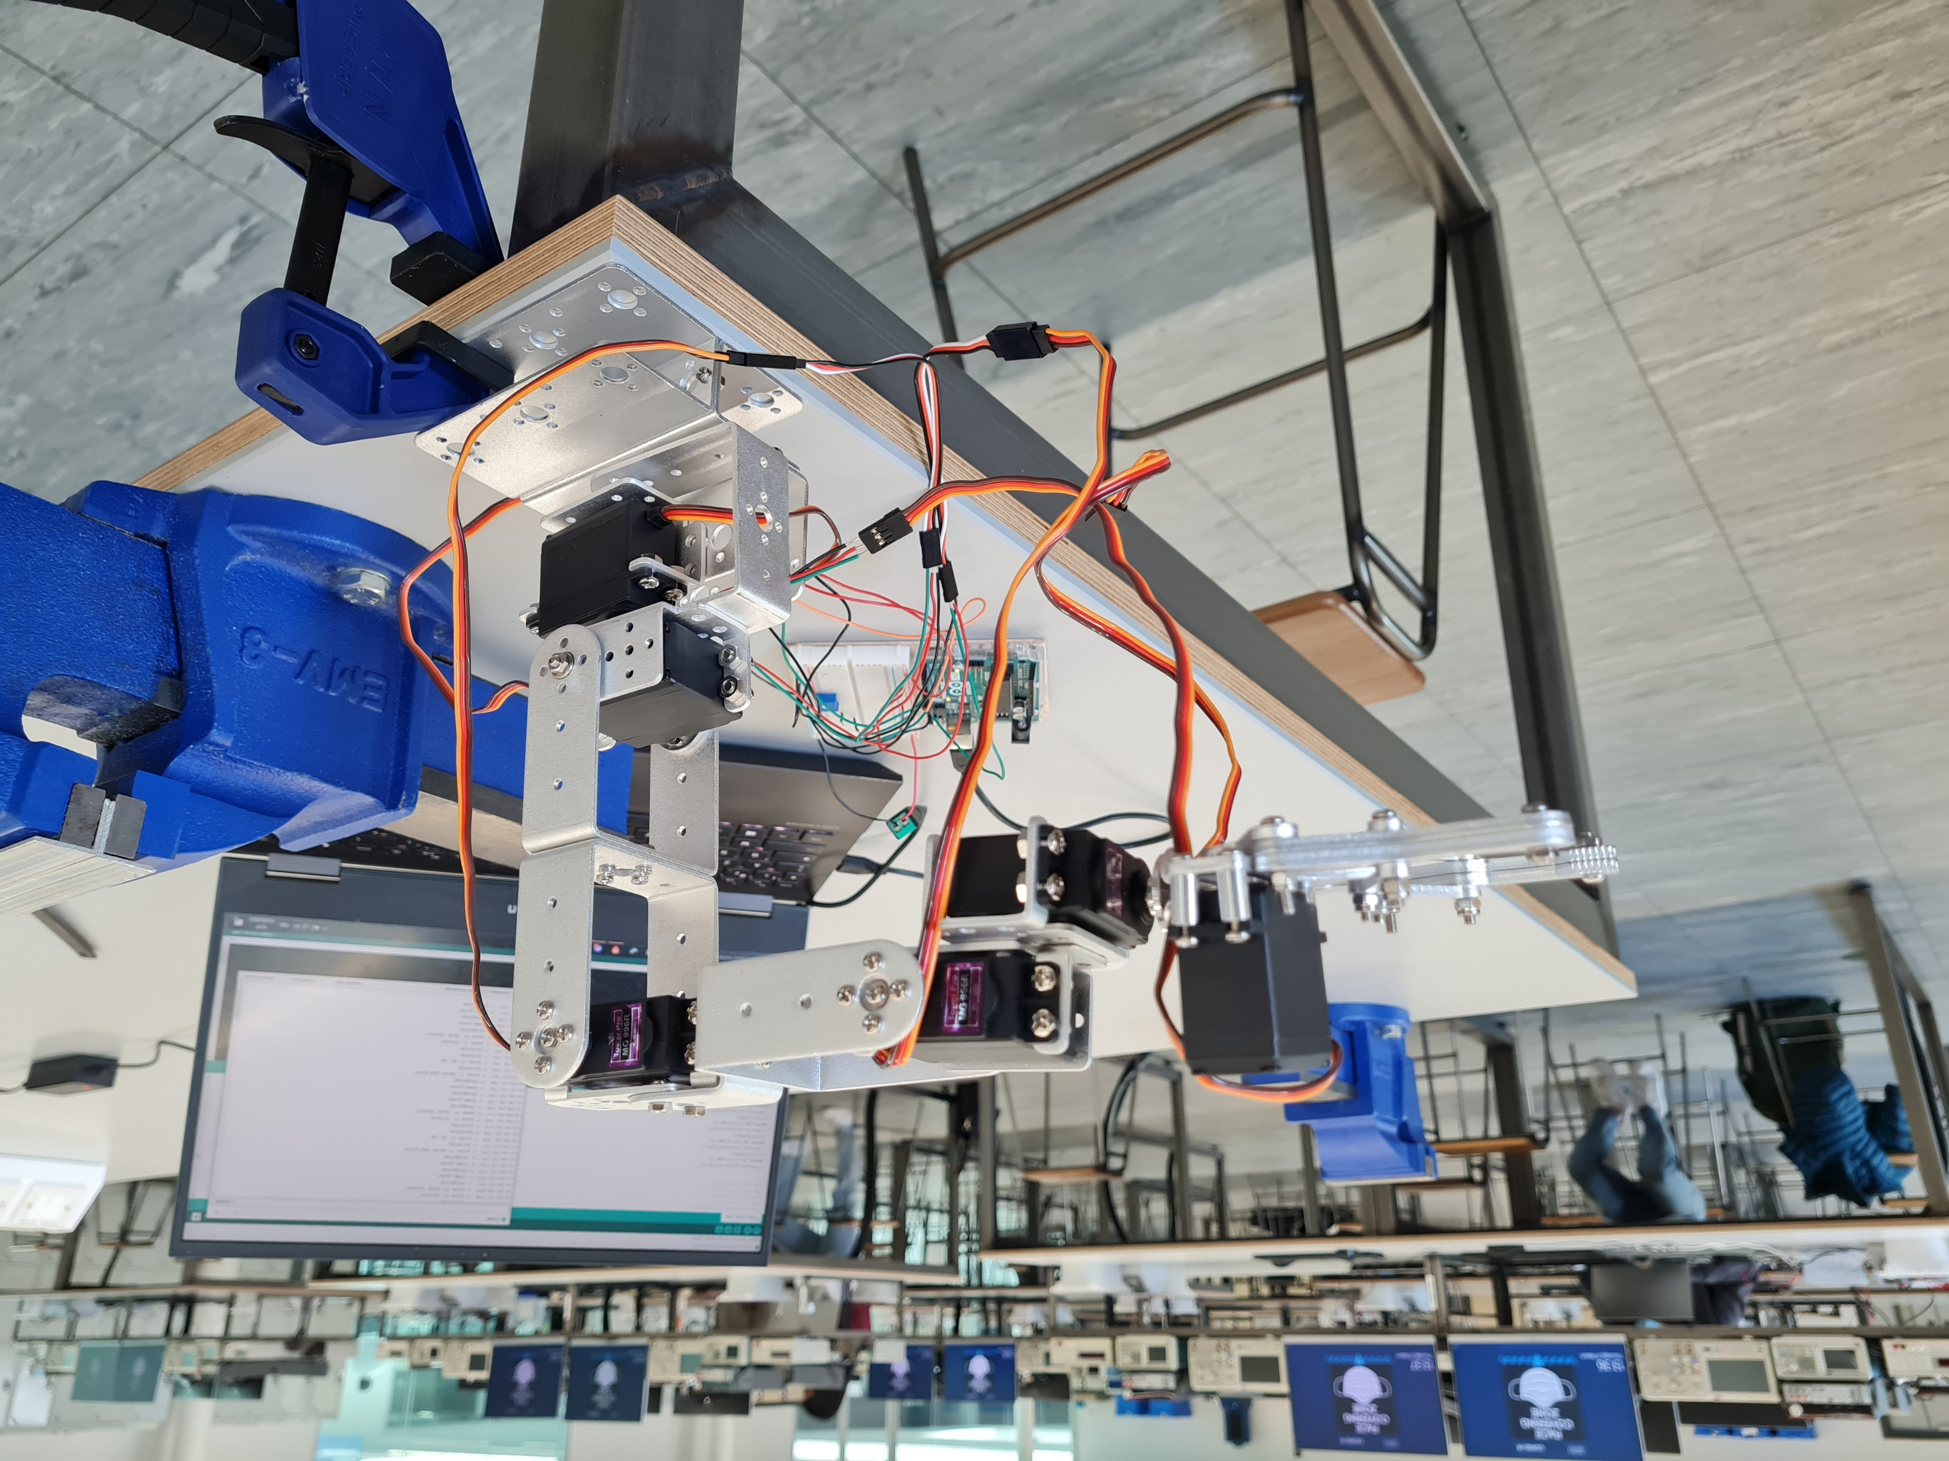
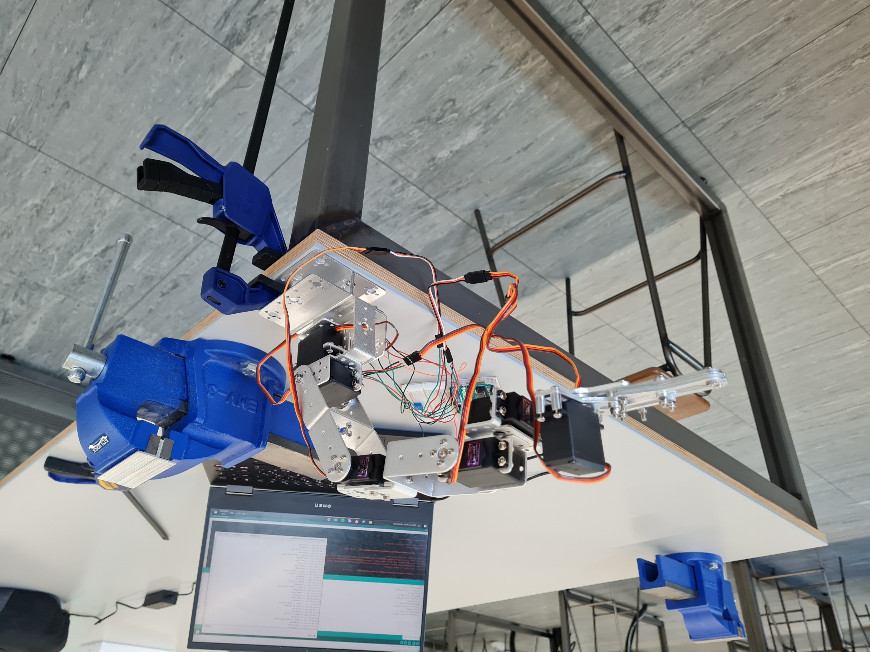
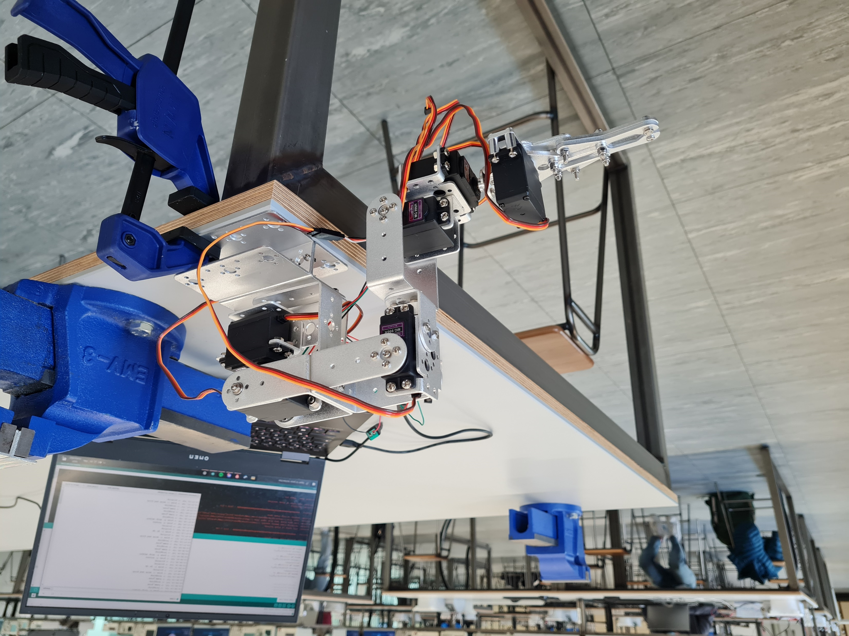
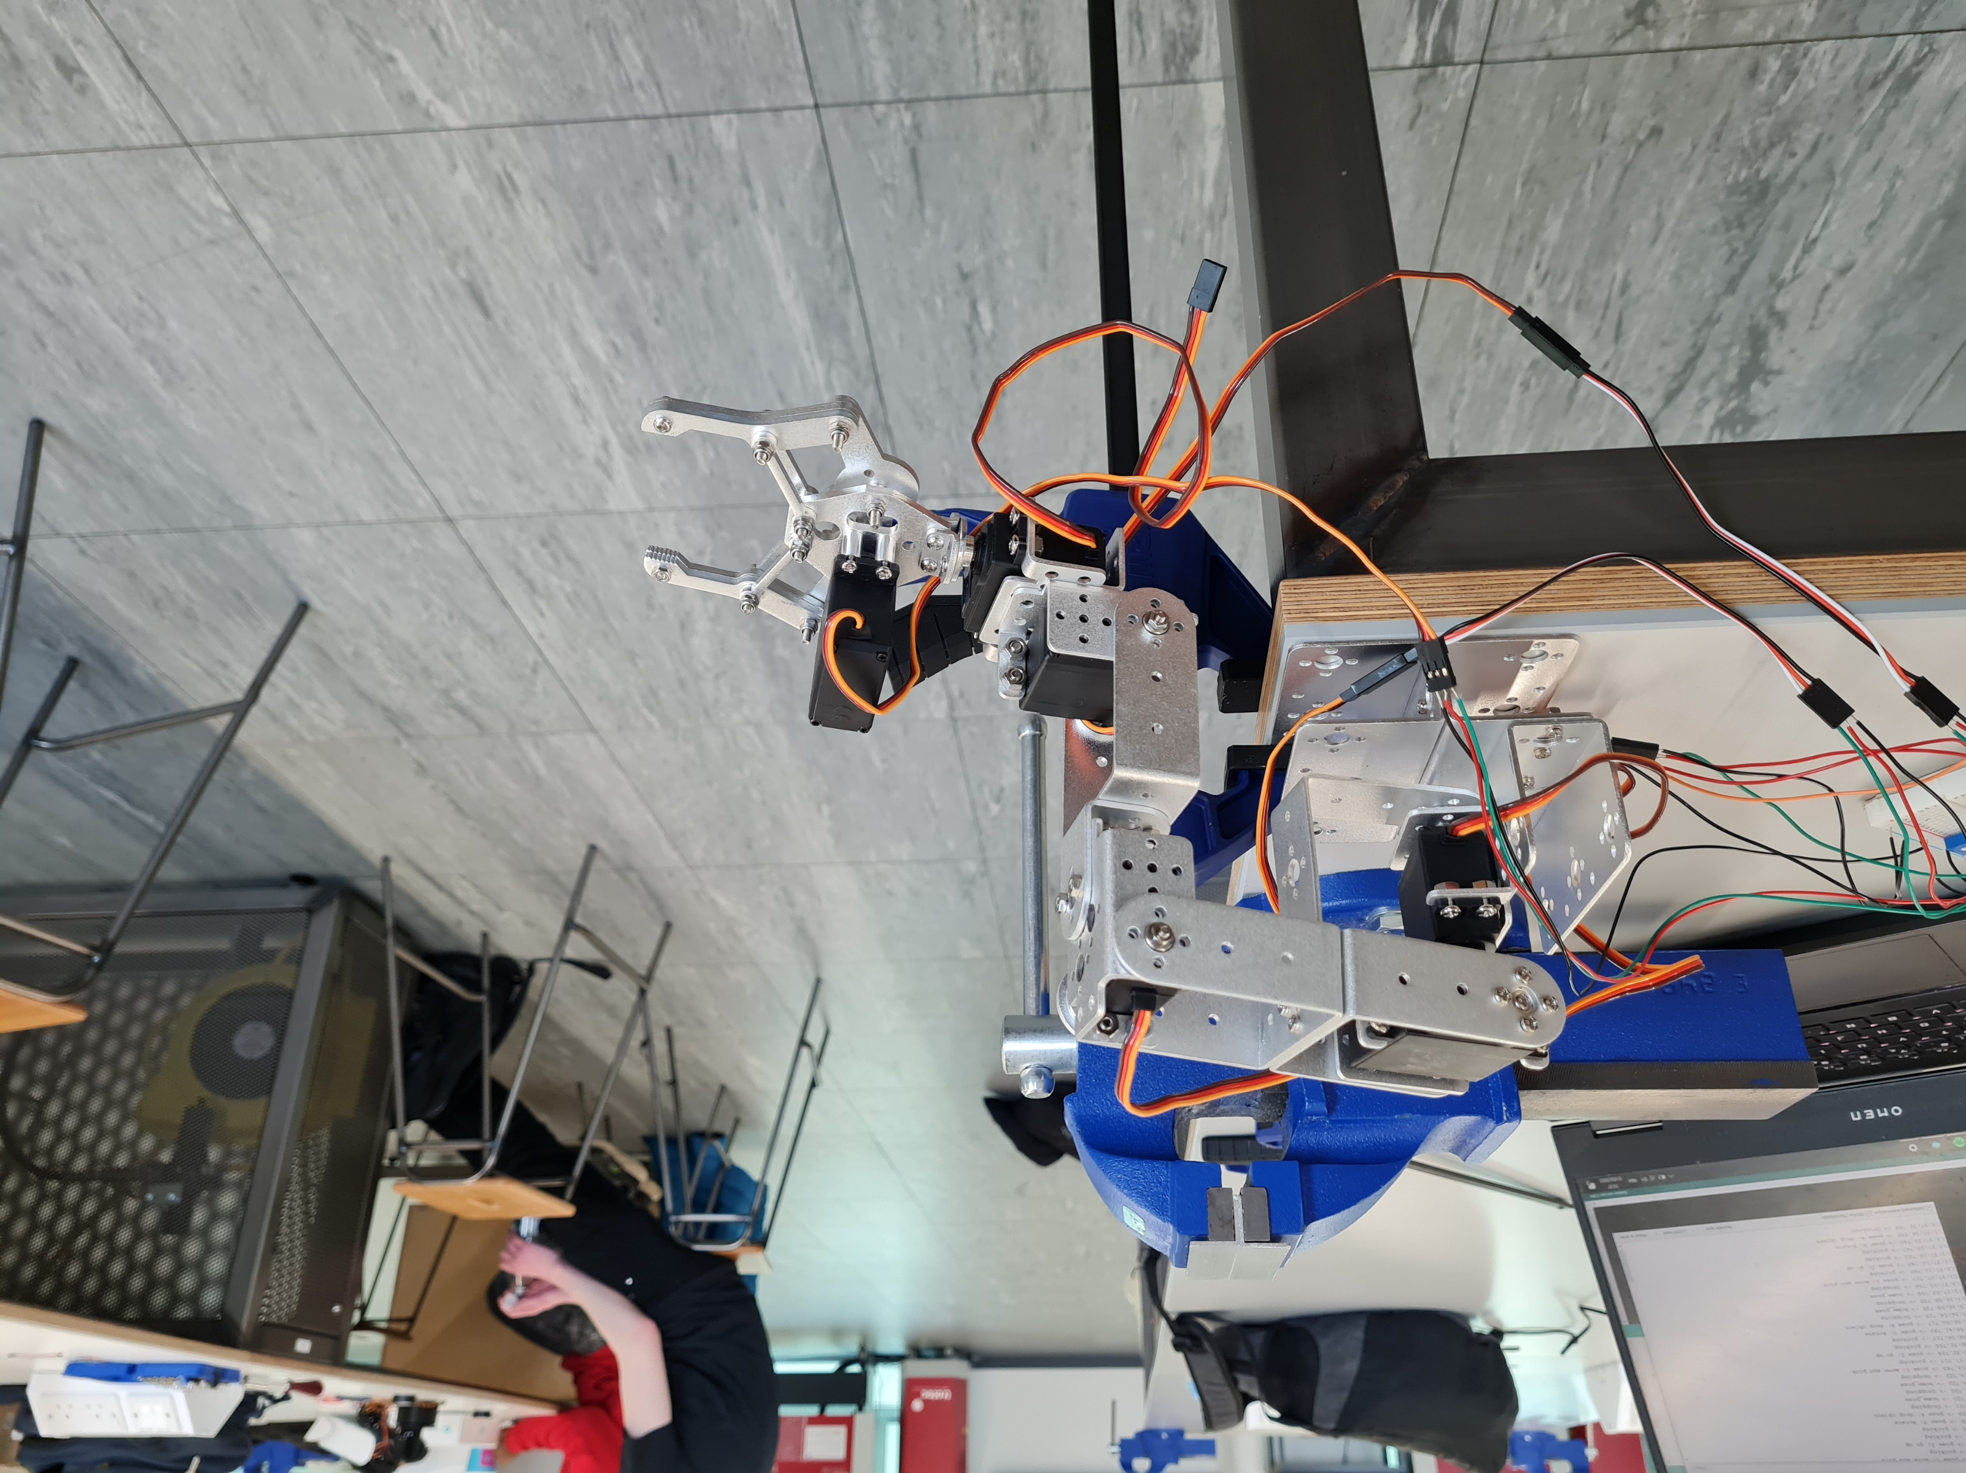
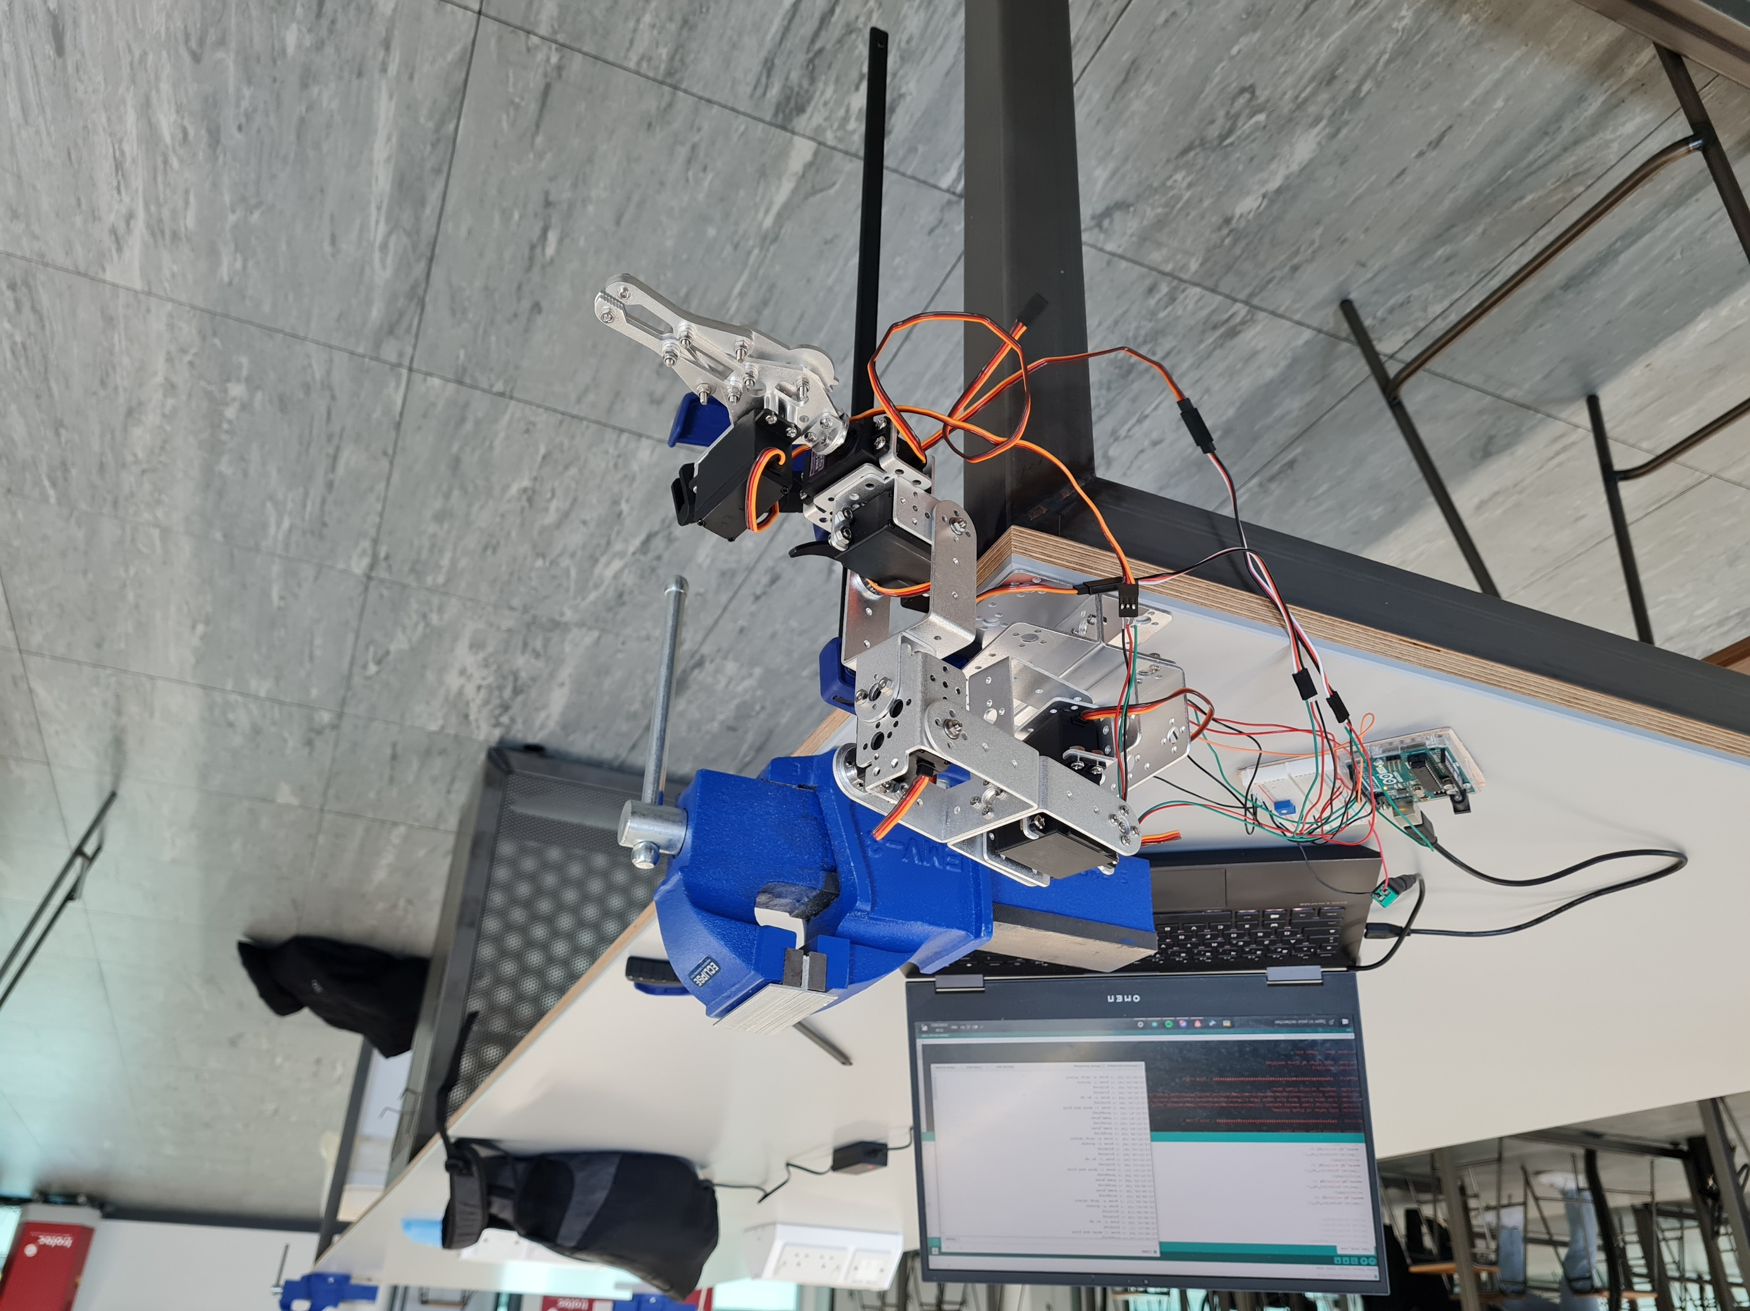
Control System
Trajectory planning

Slide 12
Control System
Inverse kinematic equation implementation
Each angle has a function
Each pose has a function
Call pose from previous slide
Call pick and drop function depending on position
These poses are called in a while loop
Control servos → control angles
Use of Servo library in Arduino

Slide 13
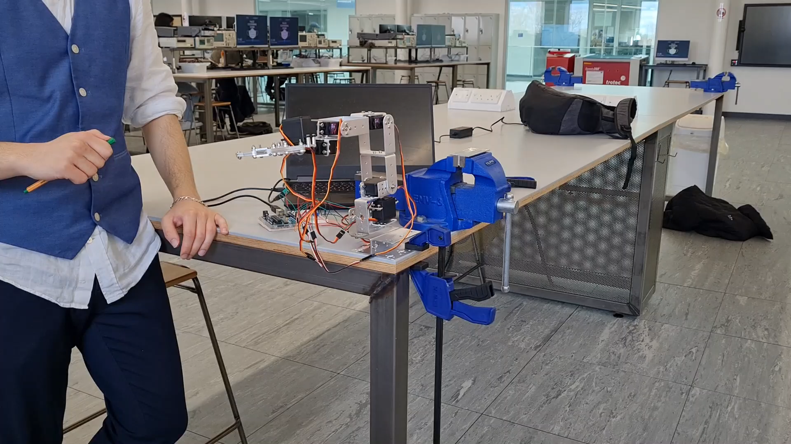
Implementation

Slide 14


Fabrication (Adrian)
Decided during design stage, all parts to be 3D printed PLA.
3D printing allows for high flexibility, PLA is inexpensive and easy to work with.
Non-gripper parts printed with 20% cubic infill for 3D strength.
Gripper parts printed with 50% grid infill because stress is only in 2D.
Example of cubic infill, strong in all directions
Example of grid infill, strong in plane of printing

Slide 15
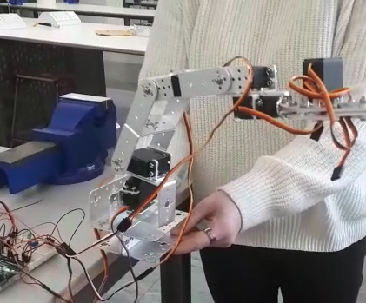
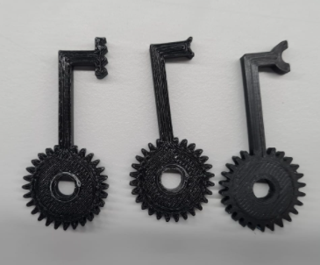
Testing and Evaluation – After build?
Completed testing
Commercially available robot arm
Future testing
Application with designed robot
Using different gripper types for best application
Robot arm used for testing electronics/control
Various iterations of gripper

Slide 16
Further Work
Testing Grippers – different shapes and different end effector options for a wider range of applications.
Servo Motor – stronger torque to allow the motor to handle rotating against opposing loads.
Stabilisation - end effectors should be more stable at their position.
Monitoring device - more precise detection for picking and dropping objects.

Slide 17
Conclusion
In conclusion, the presentation highlights the design and manufacturing process for making an assembly robot.
Even with a £60 budget, the robot was successfully created
The robotic arm had major potential to pick up a pin and insert it into the hole of a cylindrical bar.
However, in future, we can produce a more stable assembly robot that provides a stronger torque for precise movement, with improved grippers and a monitoring device to observe the pick-ups.

Slide 18
Thank you for listening.

Slide 19
Course code and name: | B50RO/B51RO - Robotic Mechanical Systems
Type of assessment: | Group
Coursework Title: | Case Study Presentation
Student Name: | Xander Irvine-Fortescue
Student ID Number: | H00300413
Declaration of authorship. By signing this form: I declare that the work I have submitted for individual assessment OR the work I have contributed to a group assessment, is entirely my own. I have NOT taken the ideas, writings or inventions of another person and used these as if they were my own. My submission or my contribution to a group submission is expressed in my own words. Any uses made within this work of the ideas, writings or inventions of others, or of any existing sources of information (books, journals, websites, etc.) are properly acknowledged and listed in the references and/or acknowledgements section. I confirm that I have read, understood and followed the University’s Regulations on plagiarism as published on the University’s website, and that I am aware of the penalties that I will face should I not adhere to the University Regulations. I confirm that I have read, understood and avoided the different types of plagiarism explained in the University guidance on Academic Integrity and Plagiarism Student Signature: Alexander Irvine-Fortescue Date: 01/04/2022

Slide 20
Course code and name: | B50RO/B51RO - Robotic Mechanical Systems
Type of assessment: | Group
Coursework Title: | Case Study Presentation
Student Name: | Sylvain Jannin
Student ID Number: | H00387879
Declaration of authorship. By signing this form: I declare that the work I have submitted for individual assessment OR the work I have contributed to a group assessment, is entirely my own. I have NOT taken the ideas, writings or inventions of another person and used these as if they were my own. My submission or my contribution to a group submission is expressed in my own words. Any uses made within this work of the ideas, writings or inventions of others, or of any existing sources of information (books, journals, websites, etc.) are properly acknowledged and listed in the references and/or acknowledgements section. I confirm that I have read, understood and followed the University’s Regulations on plagiarism as published on the University’s website, and that I am aware of the penalties that I will face should I not adhere to the University Regulations. I confirm that I have read, understood and avoided the different types of plagiarism explained in the University guidance on Academic Integrity and Plagiarism Student Signature: JANNIN Sylvain Date: 01/04/2022

Slide 21
Course code and name: | B50RO/B51RO - Robotic Mechanical Systems
Type of assessment: | Group
Coursework Title: | Case Study Presentation
Student Name: | Seun Ojuoko
Student ID Number: | H00298128
Declaration of authorship. By signing this form: I declare that the work I have submitted for individual assessment OR the work I have contributed to a group assessment, is entirely my own. I have NOT taken the ideas, writings or inventions of another person and used these as if they were my own. My submission or my contribution to a group submission is expressed in my own words. Any uses made within this work of the ideas, writings or inventions of others, or of any existing sources of information (books, journals, websites, etc.) are properly acknowledged and listed in the references and/or acknowledgements section. I confirm that I have read, understood and followed the University’s Regulations on plagiarism as published on the University’s website, and that I am aware of the penalties that I will face should I not adhere to the University Regulations. I confirm that I have read, understood and avoided the different types of plagiarism explained in the University guidance on Academic Integrity and Plagiarism Student Signature: Seun Ojuoko Date: 01/04/2022

Slide 22
Course code and name: | B50RO/B51RO – Robotic Mechanical Systems
Type of assessment: | Group
Coursework Title: | Case Study Presentation
Student Name: | Bethany Livingstone
Student ID Number: | H00299065
Declaration of authorship. By signing this form: I declare that the work I have submitted for individual assessment OR the work I have contributed to a group assessment, is entirely my own. I have NOT taken the ideas, writings or inventions of another person and used these as if they were my own. My submission or my contribution to a group submission is expressed in my own words. Any uses made within this work of the ideas, writings or inventions of others, or of any existing sources of information (books, journals, websites, etc.) are properly acknowledged and listed in the references and/or acknowledgements section. I confirm that I have read, understood and followed the University’s Regulations on plagiarism as published on the University’s website, and that I am aware of the penalties that I will face should I not adhere to the University Regulations. I confirm that I have read, understood and avoided the different types of plagiarism explained in the University guidance on Academic Integrity and Plagiarism Student Signature: Bethany Livingstone Date: 01/04/2022

Slide 23
Course code and name: | B50RO/B51RO – Robotic Mechanical Systems
Type of assessment: | Group
Coursework Title: | Case Study Presentation
Student Name: | Adrian Wendland
Student ID Number: | H00215700
Declaration of authorship. By signing this form: I declare that the work I have submitted for individual assessment OR the work I have contributed to a group assessment, is entirely my own. I have NOT taken the ideas, writings or inventions of another person and used these as if they were my own. My submission or my contribution to a group submission is expressed in my own words. Any uses made within this work of the ideas, writings or inventions of others, or of any existing sources of information (books, journals, websites, etc.) are properly acknowledged and listed in the references and/or acknowledgements section. I confirm that I have read, understood and followed the University’s Regulations on plagiarism as published on the University’s website, and that I am aware of the penalties that I will face should I not adhere to the University Regulations. I confirm that I have read, understood and avoided the different types of plagiarism explained in the University guidance on Academic Integrity and Plagiarism Student Signature: Adrian Wendland Date: 01/04/2022

